Slide 1
Introduction to Azure Data Factory
Koen Verbeeck

Slide 2






contact
Koen Verbeeck
@Ko_Ver
SQLkover.com

Slide 3
what is Azure Data Factory?

Slide 4
A fully managed, serverless data integration service. Visually integrate data sources with more than 90 built-in connectors at no added cost. Easily construct ETL and ELT processes code-free in an intuitive environment or write your own code.

Slide 5
A fully managed, serverless data integration service. Visually integrate data sources with more than 90 built-in connectors at no added cost. Easily construct ETL and ELT processes code-free in an intuitive environment or write your own code.

Slide 6
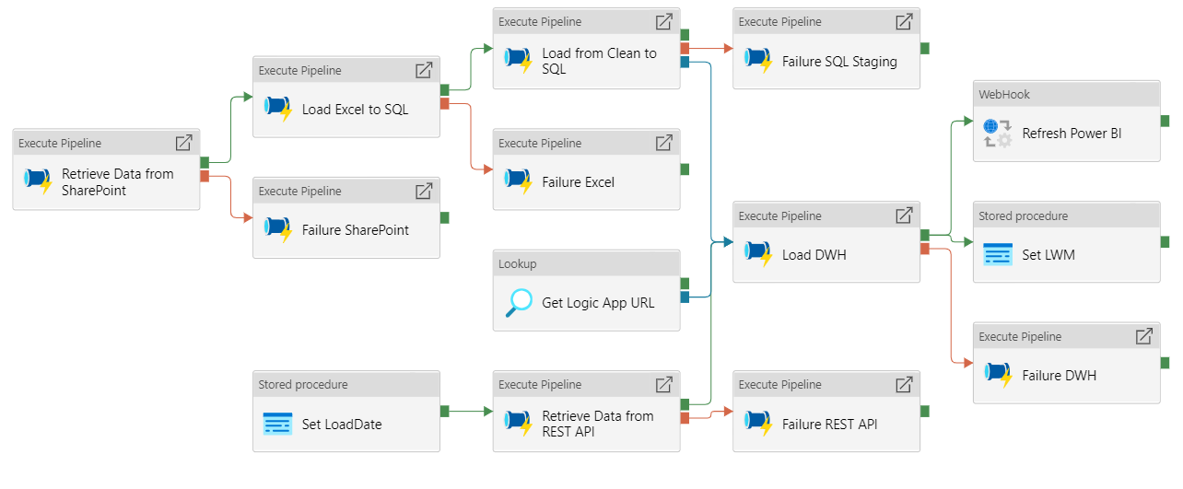
Notes:
Compare with tools like SSIS and Pentaho.

Slide 7
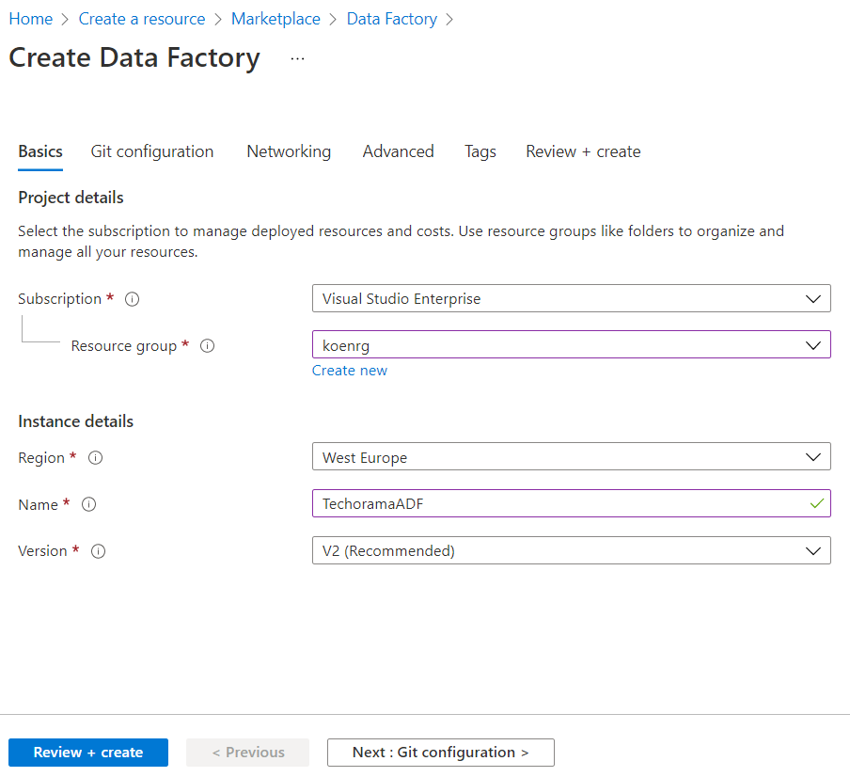

Slide 8
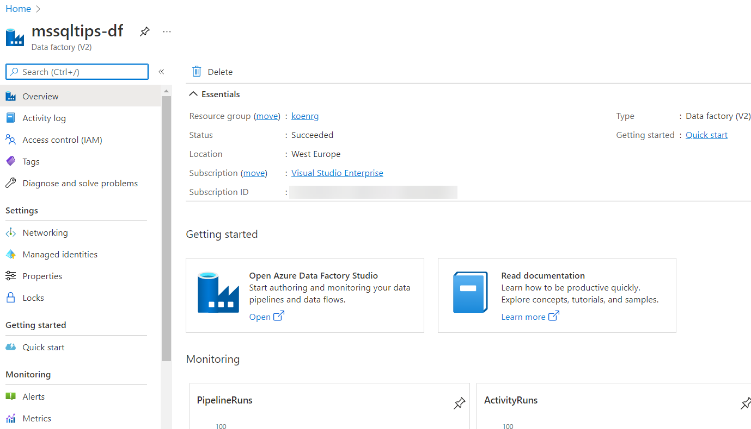

Slide 9
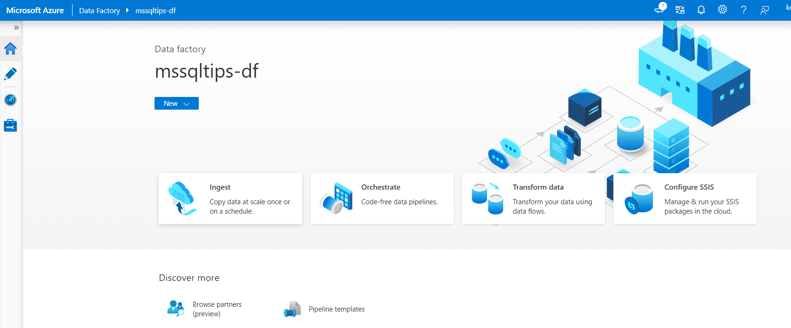

Slide 10
some terminology

Slide 11
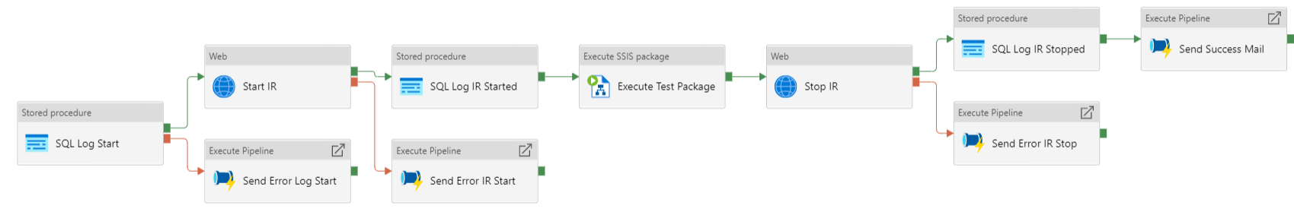
pipeline

Slide 12
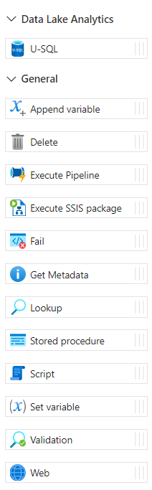
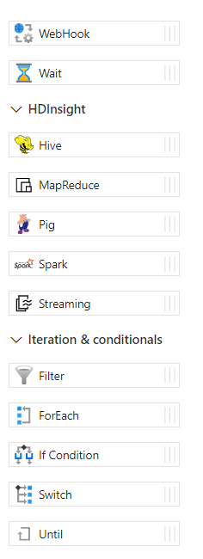
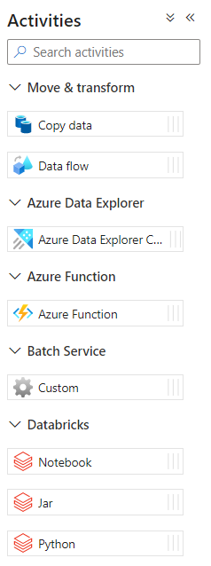
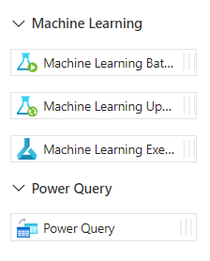
activities
Notes:
Activies perform a certain task.
Execute a script on a database
Start a Databricks Notebook
Call a Logic App using an HTTP call
Copy Data from A to B

Slide 13

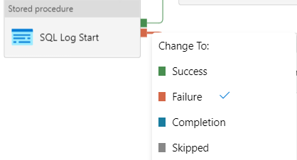
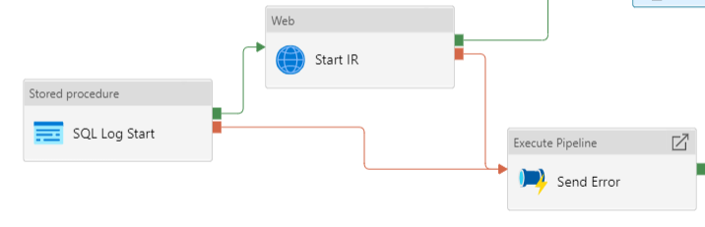
activities

Slide 14
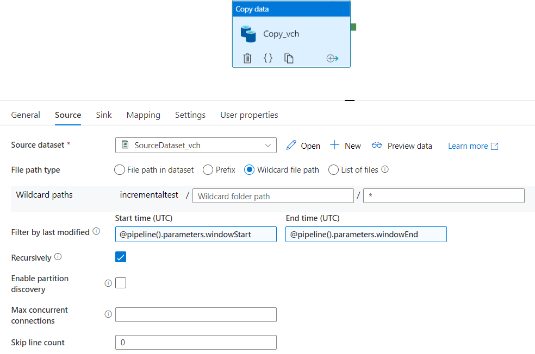
copy activity

Slide 15
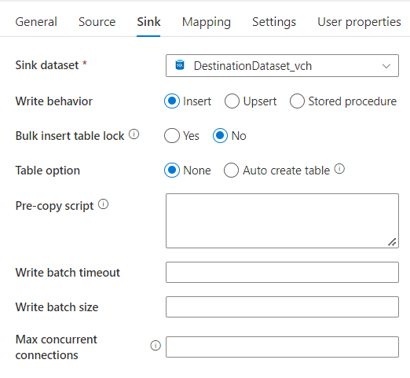
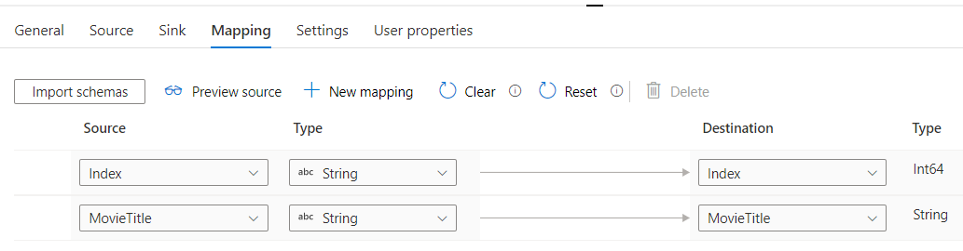
copy activity

Slide 16
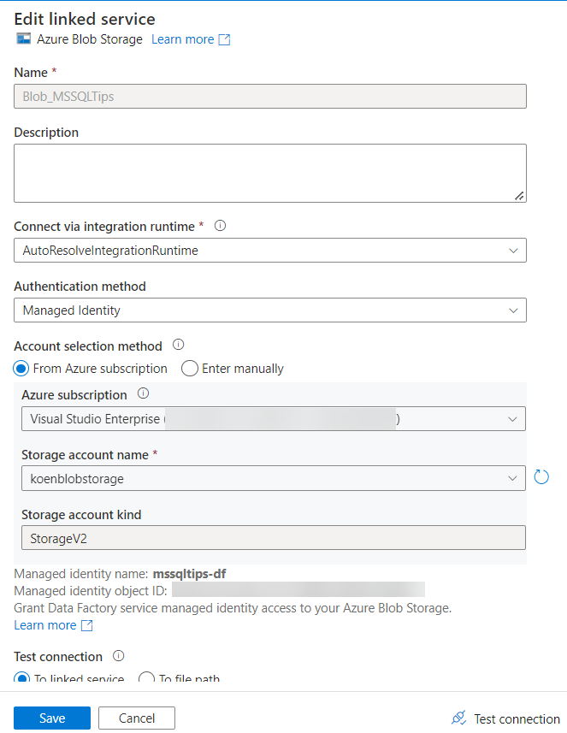

linked service
points to a certain data location
contains info on how to authenticate
can integrate with Azure Key Vault

Slide 17
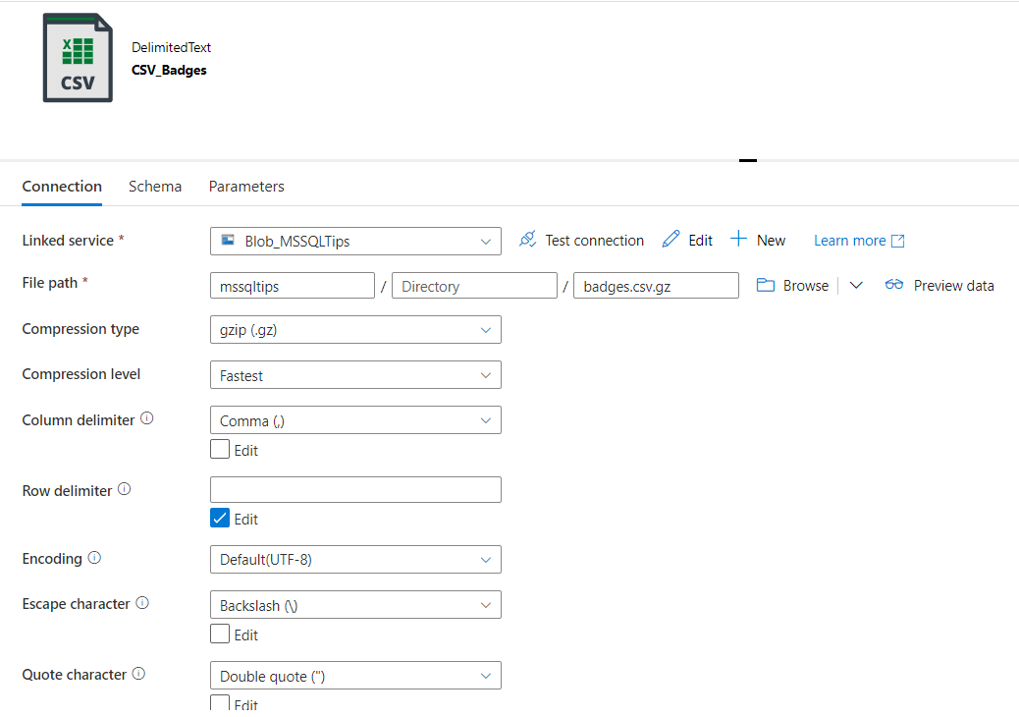
data set
Notes:
defines format of the data

Slide 18
DEMO
Notes:
Show a simple pipeline (through copy wizard)

Slide 19

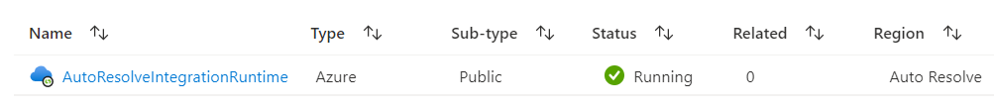


integration runtimes

Slide 20
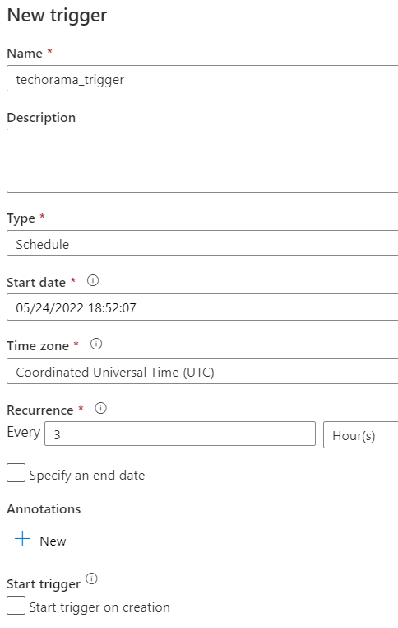

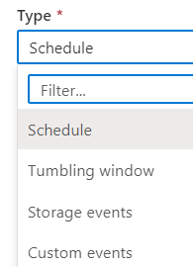
triggers

Slide 21
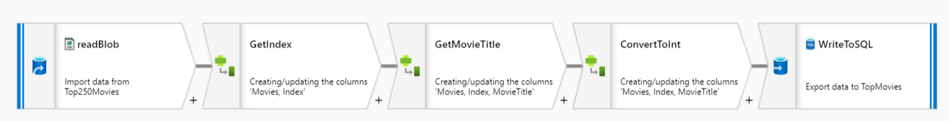
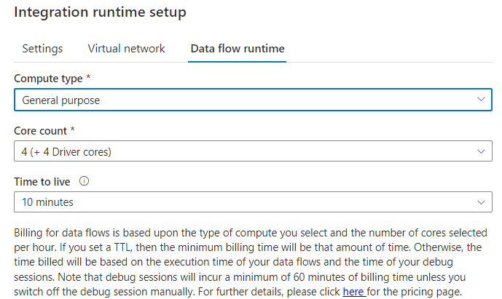
data flow

Slide 22
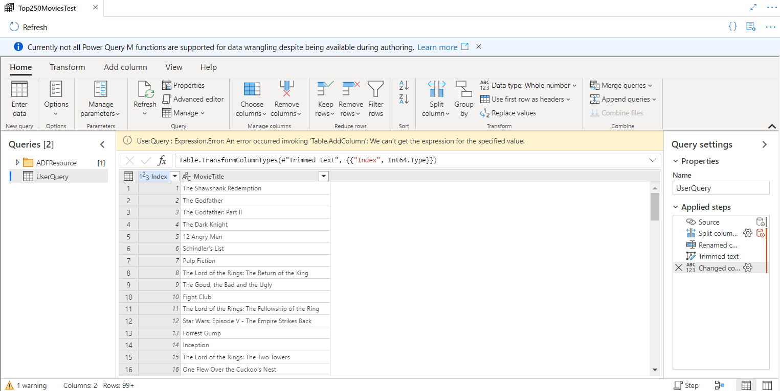
power query

Slide 23

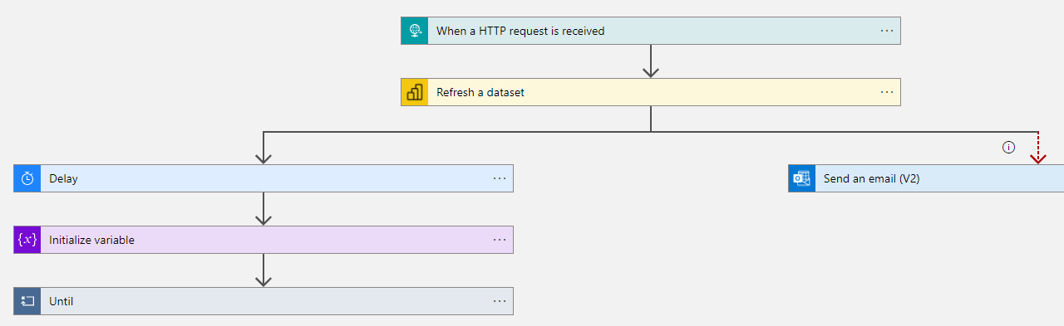

if it’s not in ADF?
Azure Functions
Azure Logic Apps
SSIS?
or do it in SQL/Python/…

Slide 24
git integration

Slide 25
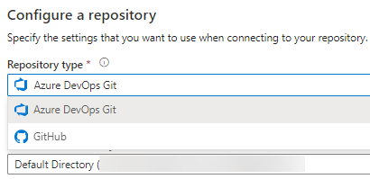
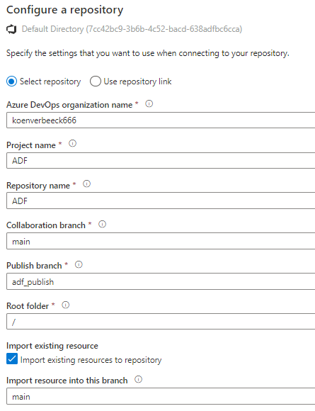
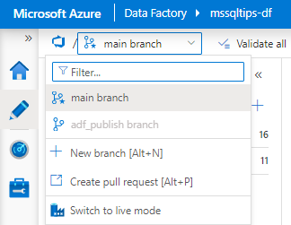

Slide 26

DEV git integrated
PRD live mode
main
feat A

Slide 27
DEV git integrated
PRD live mode
main
feat A
pull request
publish

Slide 28
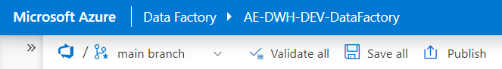
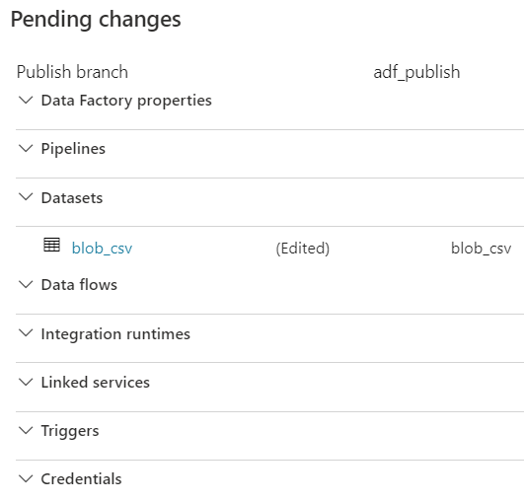
intermezzo!

Slide 29





DEV git integrated
PRD live mode
main
adf_publish
feat A
pull request
publish

Slide 30
metadata ftw

Slide 31
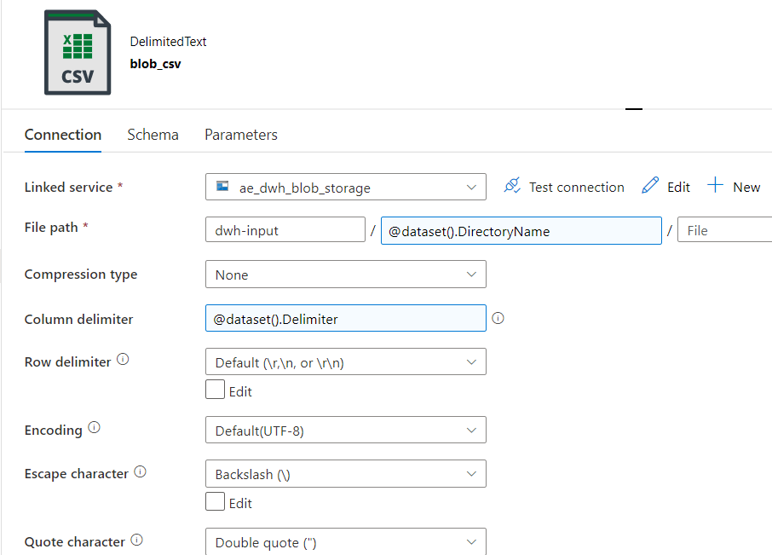
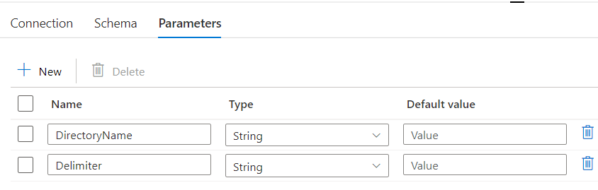
parameterize everything

Slide 32
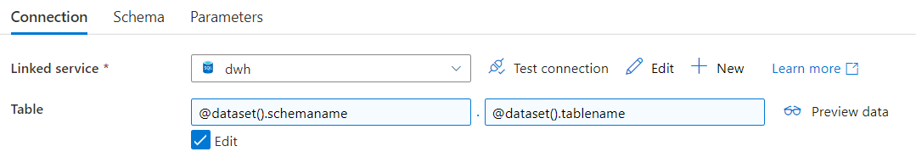
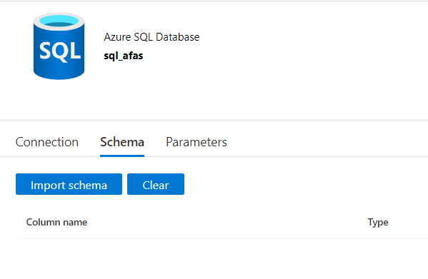
parameterize everything

Slide 33
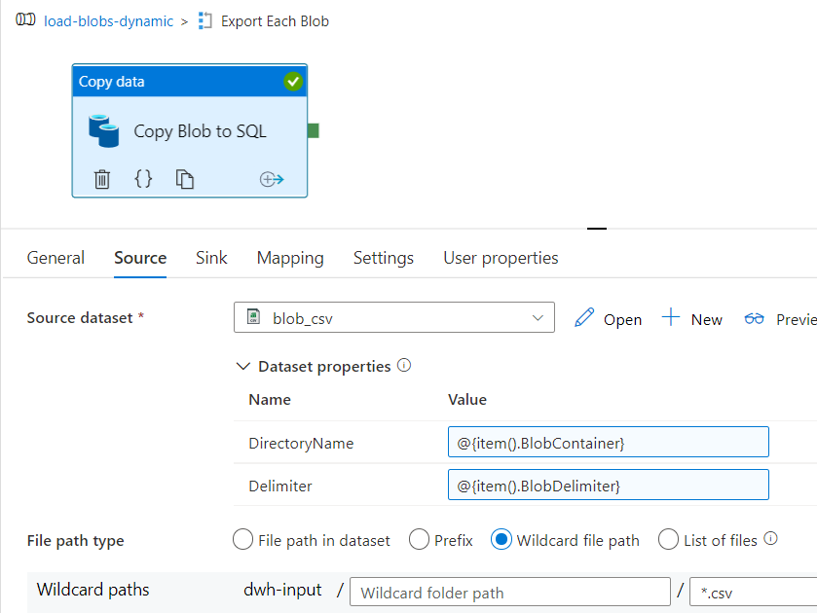
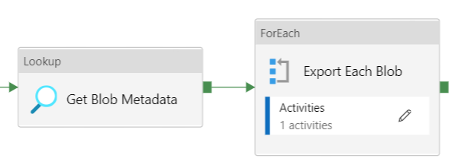
fetch metadata & loop

Slide 34
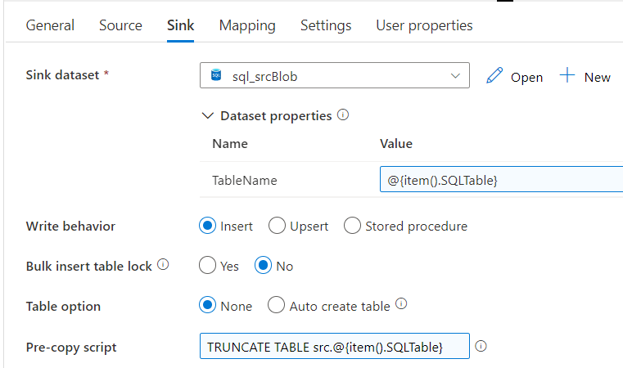
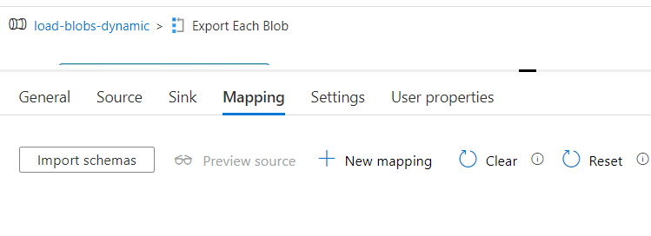
fill in parameters at runtime
no need for mapping in simple use cases
use dynamic content

Slide 35
DEMO
dynamically import Excel files

Slide 36
cost

Slide 37
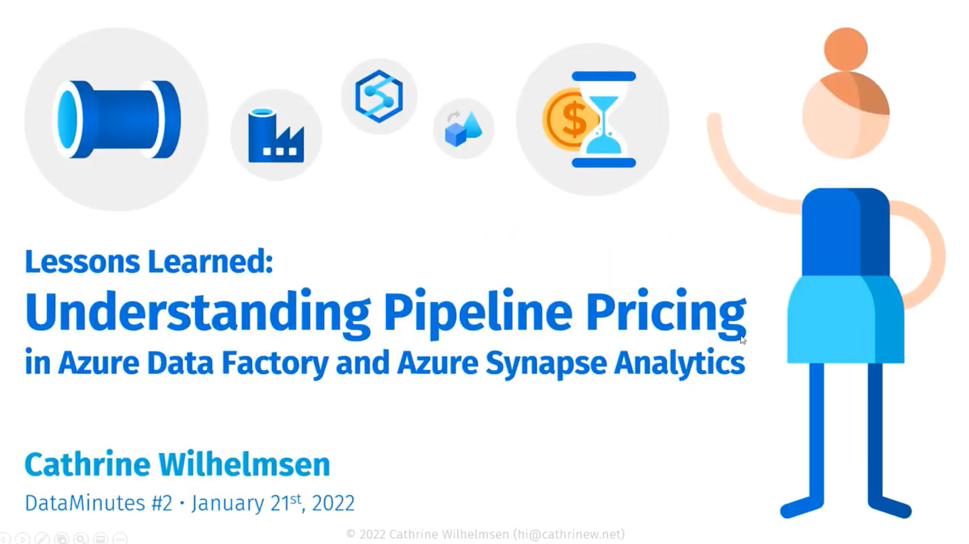
https://youtube.com/watch?v=Fct1dcZMyWs

Slide 38
important to remember
ALL ACTIVITIES ARE PRO-RATED BY THE MINUTE
AND ROUNDED UP

Slide 39
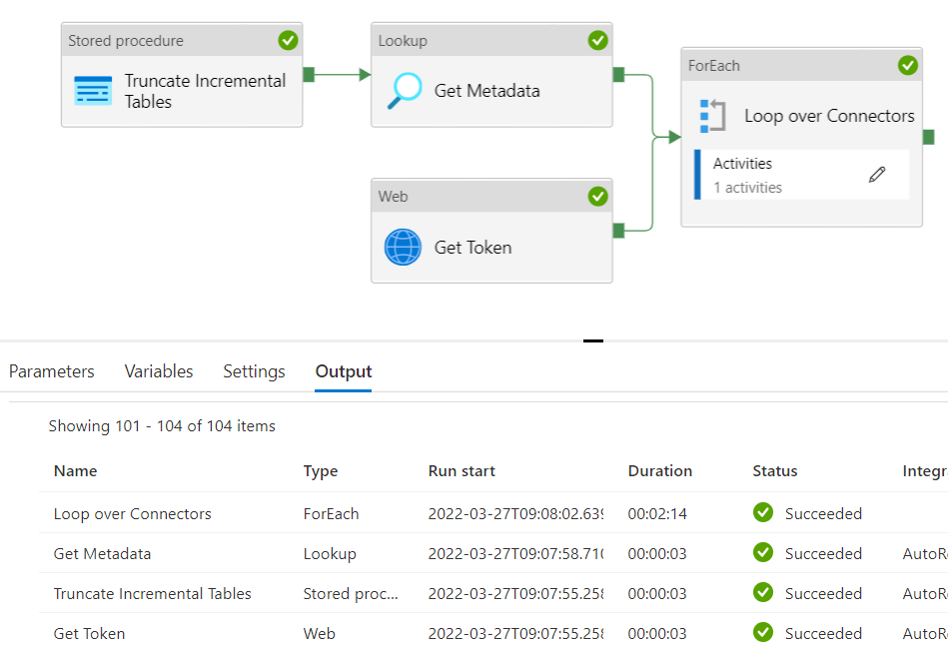
example
2 minutes and 23 seconds runtime

Slide 40
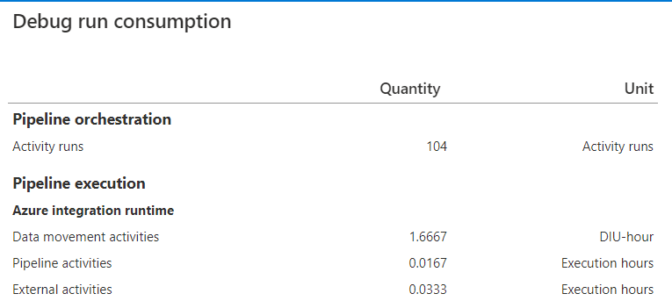
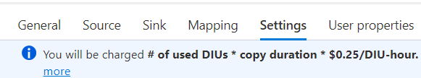
example
Orchestration (Azure-IR): $0.001/run
Pipeline (Azure-IR): $0.005/hour
$0,0000835/run
External (Azure-IR): $0.00025/hour
$0,000008325/run
Data Movement (Azure-IR): $0,25/hour
→ 2 * 1.6667 * $0.25 = $0,83335/run
$0,834441825 / run
once every day: $25.03
once every hour: $600.80
once every 5 min: $7209.58
1 minute
100 minutes!
2 minutes

Slide 41
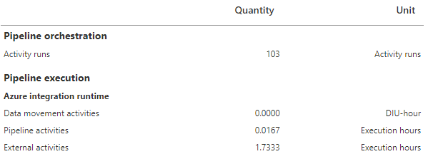
example
Orchestration (Azure-IR): $0.001/run
Pipeline (Azure-IR): $0.005/hour
$0,0000835/run
External (Azure-IR): $0.00025/hour
$0,000433325/run
+ cost of Azure Function
$0,001516825 / run
once every day: $0.05
once every hour: $1.09
once every 5 min: $13.11
1 minute
0 minutes!
104 minutes

Slide 42
conclusion

Slide 43
conclusion
ADF is an easy to use, scalable, visual, ELT data integration service
it integrates nicely with git and Azure Devops
many connectors out-of-the-box
don’t fall into old patterns
it’s definitely not a streaming service

Slide 44
resources
Cathrine Wilhelmsen - Beginner's Guide to Azure Data Factory
Andy Leonard – Blog about SSIS and ADF
Paul Andrew – Blog about ADF
MSSQLTips.com – All ADF Tips & Intro to ADF tutorial
Lots of conferences have recordings online

